Slide 1
Benchmarking Quasi-Steady State Cascading Outage Analysis Methodologies
IEEE Working Group on Understanding, Prediction, Mitigation and Restoration of Cascading Failures

Slide 2
Introduction
Planners and operators must ensure the security of power systems
Must be able to withstand disturbances, to some extent
Traditional way: deterministic criteria
The power system must be secure against a range of events
E.g. N-1 security criterion
Two types of analyses
Quasi-steady-state (power flow)
Dynamic
Various tools with some differences (especially for dynamic analysis), but confidence that they will lead to the (nearly) same conclusions (in the large majority of cases)

Slide 3
Introduction
Trend to complement (or to replace) deterministic security criteria by probabilistic security criteria
Estimation of the risk for unsecure contingencies?
Need to simulate what happens after → simulation of cascading outages
Several existing methodologies/tools
Does a power system engineer reach the same conclusions about the risk of cascading outage and the needed remedial actions using the different tools?
Overall risk, criticalities, etc.
Necessity to benchmark cascading outage analysis methodologies

Slide 4
Agenda
Introduction
Methodologies
Results
Conclusions & perspectives

Slide 5
Methodologies

Slide 6
Methodologies
Classification of methodologies according to the way electrical variables are computed after each cascading event
Static computation (QSS methodologies)
Dynamic computation (dynamic methodologies)
Combination of both (hybrid methodologies)

Slide 7
Methodologies
Many QSS cascading outage analysis methodologies
Follow a similar pattern
But specificities in the implementation…

Slide 8
Methodologies
Name | Type | Consideration of initiating events | Selection of the ulterior events | Contingency list | Cascading mechanisms
Manchester | R&D | Probabilistic | Probabilistic | Monte Carlo | OL,HF,FI
OPA | R&D | Probabilistic | Probabilistic | Monte Carlo | OL
Practice | R&D | Probabilistic | Probabilistic | Enumeration | OL,HF,VV,FI
PCM | © | Deterministic | Deterministic | Enumeration | OL,VV,VI
Transmission 2000 | © | Probabilistic | Deterministic | Enumeration | OL,VV
PSS/E | © | Probabilistic | Deterministic | Enumeration | OL,VV,VI
TransCare | © | Deterministic | Deterministic | Enumeration | OL,VV,VI
OL=Line Overloads, HF=Hidden Failures, VV=Voltage Violations, VI=Voltage Instability, FI=Frequency Instability

Slide 9
results

Slide 10
Results
Test system: IEEE 3-area RTS (1996)

Slide 11
Results
Metrics
Expected demand loss
Distribution of demand loss
Non-linearity: one large blackout does not have the same impact as multiple events equivalent in EENS
Distribution of line outages
Critical lines

Slide 12
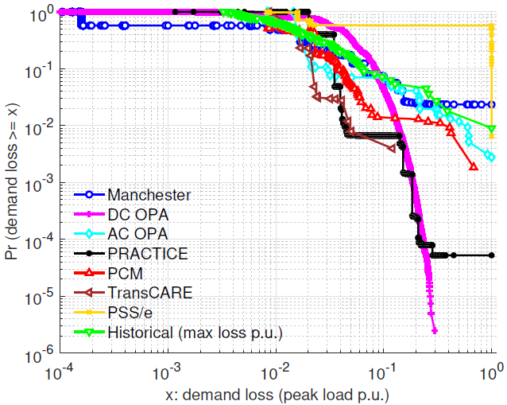
Results
Demand loss
Conditional probability, given that demand loss occurred in the system
Methodology | Expected demand loss (MW/year)
Manchester | 189.4
DC OPA | 130.7
Practice | 250.5
PSS/E | 79.8

Slide 13
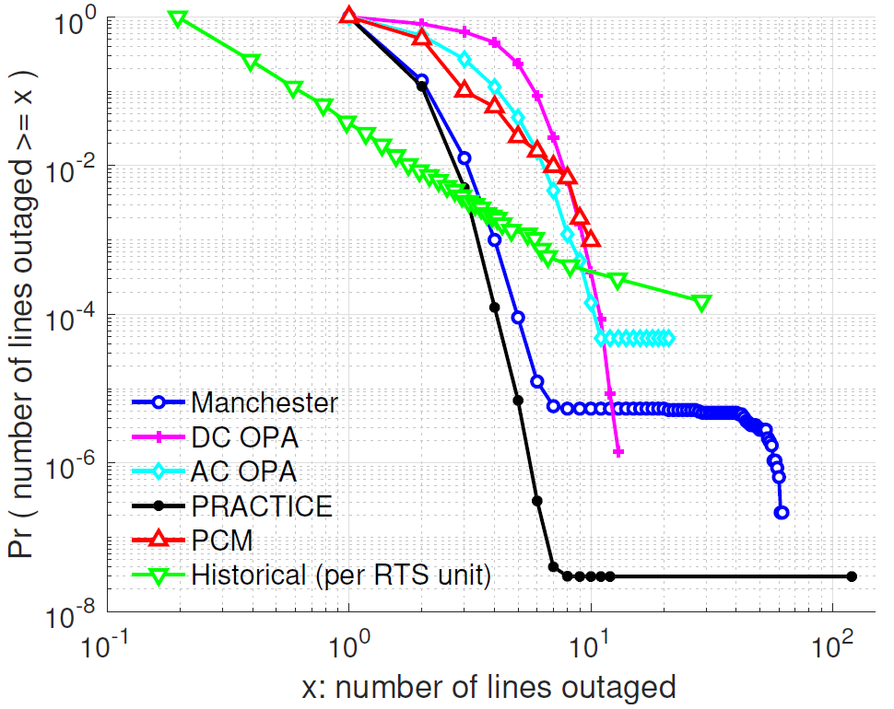
Results
Distribution of line outages

Slide 14
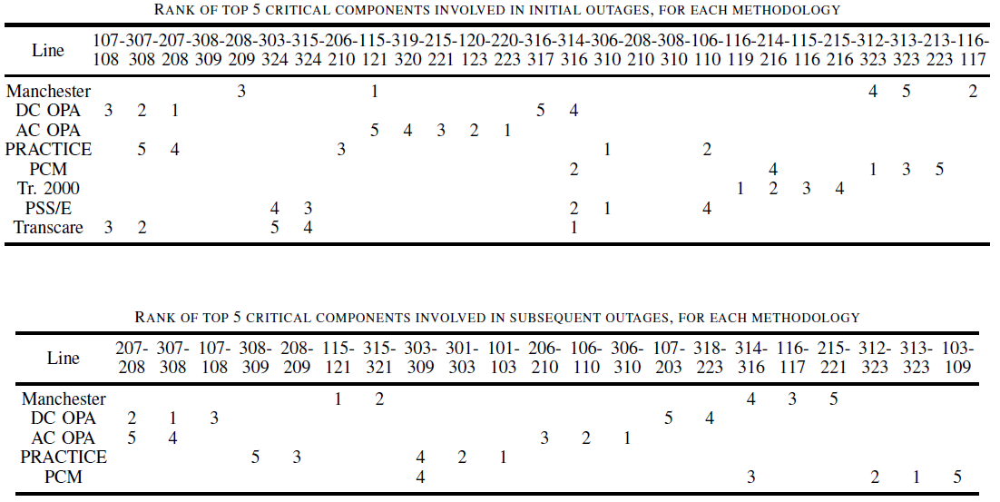
Results
Critical lines
Different mechanisms modelled, different criteria to select critical lines, …

Slide 15
Conclusions & perspectives

Slide 16
Conclusions & perspectives
Results: estimation of the average risk is of the same order of magnitude for the different methodologies, but large variation in distributions and in critical elements
Conclusions about planning and operation actions to take: strongly rely on the specific cascading outage analysis methodology used
Major barrier hampering the use of assessment of the risk of cascading outage in planning and operation processes
Additional R&D work needed to narrow down the range of results obtained from the different QSS cascading outage methodologies
Clarification of the simulation objectives (e.g. risk assessment or NERC TPL compliance)
Cascading phenomena to model, level of detail, uncertainties to consider, linked data and sampling strategies
Result interpretation and metrics
Validation with observed cascading statistics

