Slide 1



Software Testing Education and Training: How can we train top-quality Software Test Engineers?
Vahid Garousi, PhD, PEng
Associate Professor of Software Engineering
Software Quality Engineering Research Group (SoftQual)
Department of Electrical and Computer Engineering
Schulich School of Engineering
University of Calgary (UofC)
Calgary, Alberta, Canada
IEEE Computer Chapter Chair - Southern Alberta Section
An invited talk for the IEEE Computer Chapter Vancouver
May 2012

Slide 2

Outline of the Talk
Brief introduction to Software Engineering Research at the UofC
Then, the talk itself…

Slide 3
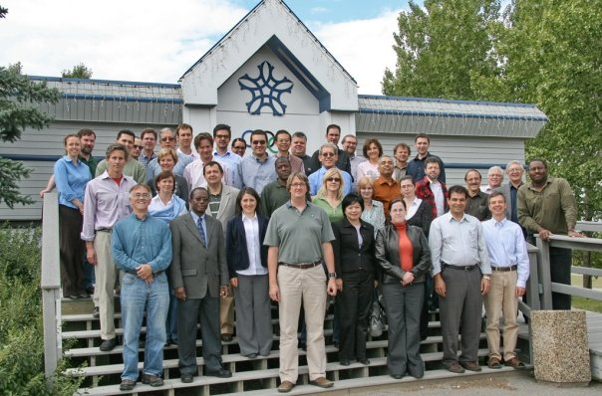
Brief introduction to Software Engineering Education and Research at the UofC
We have software engineering researchers in both the ECE and the CS departments
In ECE, we offer a Bachelors degree in software engineering
Both department together have in total about 75 faculty members
About 8 professors do research in software engineering
ECE Faculty Members, 2008

Slide 4
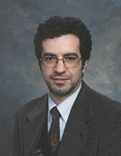
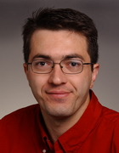
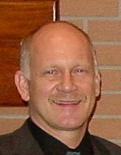
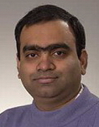
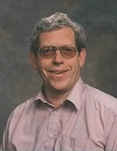
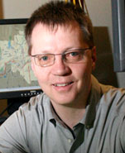
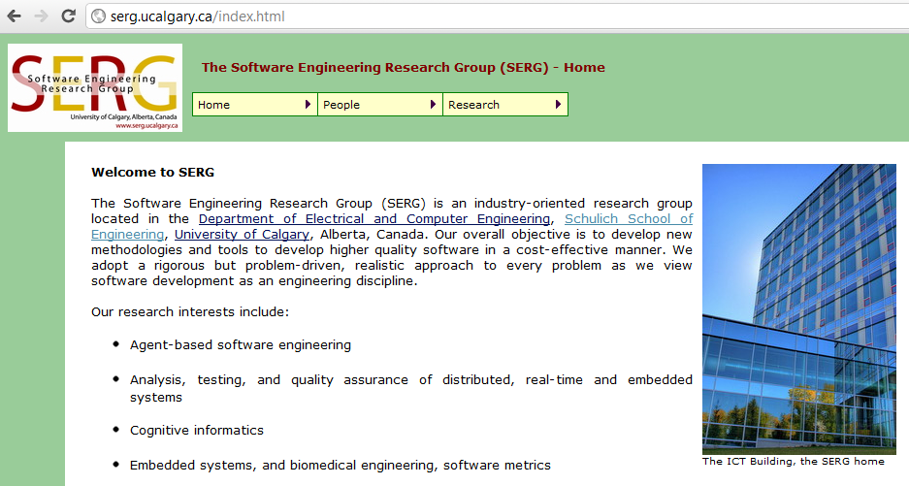


Software Engineering Research Areas in the UofC
Agent-based software engineering
Agile software engineering
Software Testing, and Software Test Engineering
Software Engineering based on the Unified Modeling Language (UML)
Software Engineering Decision Support
Software Performance Engineering
More in www.serg.ucalgary.ca

Slide 5
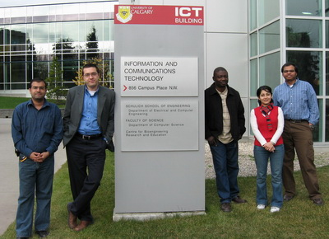
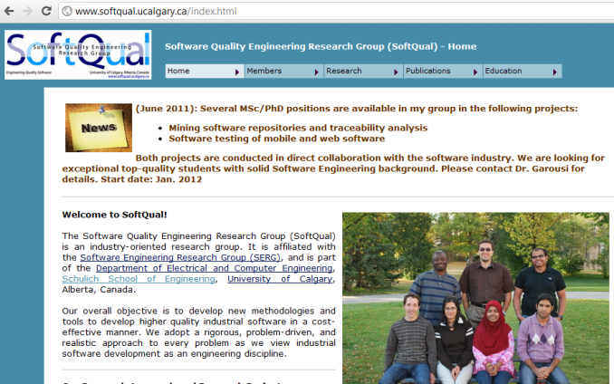
Brief introduction to the UofC’s Software Quality Engineering Research Group (SoftQual)
www.softqual.ucalgary.ca
Current students:
  1 PDF research associate
  1 PhD student
  3 MSc students
  3 undergraduate students
Alumni
  7 MSc
  17+ undergraduate students
  1 PDF research associate
All our projects are applied R&D
Source of funding:
  Governmental agencies such as Natural Sciences and Engineering Research Council of Canada (NSERC), Alberta Innovates, etc.
  Industrial collaborators (via R&D projects): IBM, Siemens, NovAtel, MR Control Systems, Analog Devices

Slide 6
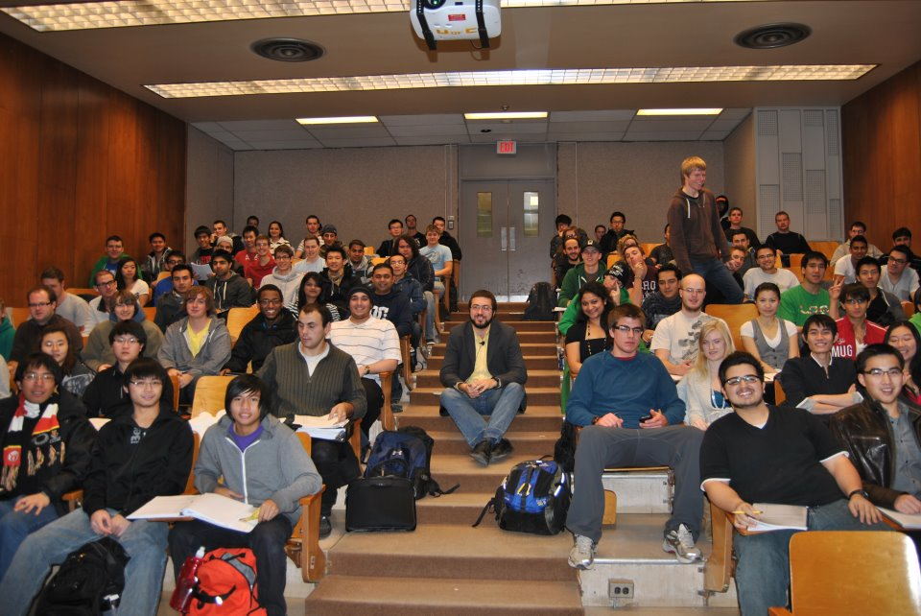

My background in SW engineering and SW testing education
I have been teaching SW engineering and SW testing courses since 2006 in both graduate and undergraduate levels
Have been providing corporate training to software companies in the Calgary and a few other Canadian cities.
Also, offering evening courses through the University of Calgary Continuing Education
Courses: UML, Java, OO, SW engineering, SW testing, SW reliability

Slide 7
Outline of the Talk
Background and Introduction
Why is software testing important?
An Overview of SW engineering education research
SW testing research versus SW testing education research
What do we need to teach in testing courses?
What do we need to train top-quality Software Test Engineers?
  Good books
  Good testing tools
  Good teaching materials
  What does the SW industry really need?

Slide 8
Outline of the Talk
Background and Introduction
Why is software testing important?
An Overview of SW engineering education research
SW testing research versus SW testing education research
What do we need to teach in testing courses?
What do we need to train top-quality Software Test Engineers?
  Good books
  Good testing tools
  Good teaching materials
  What does the SW industry really need?

Slide 9
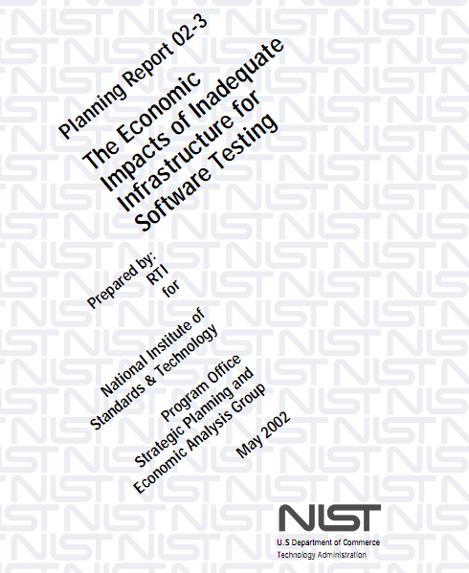
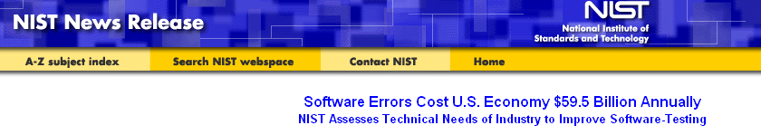
Why is SW testing important?
A study by (the American) NIST in 2002: The annual national cost of inadequate testing is as much as $59 Billion US!
  The report is titled: “The Economic Impacts of Inadequate Infrastructure for Software Testing”
  http://www.nist.gov/public_affairs/releases/n02-10.htm

Slide 10

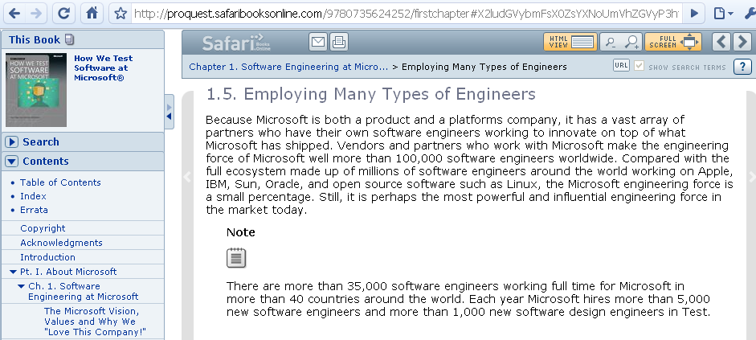
Software testing Jobs
Software test engineer != Software tester
SDET

Slide 11
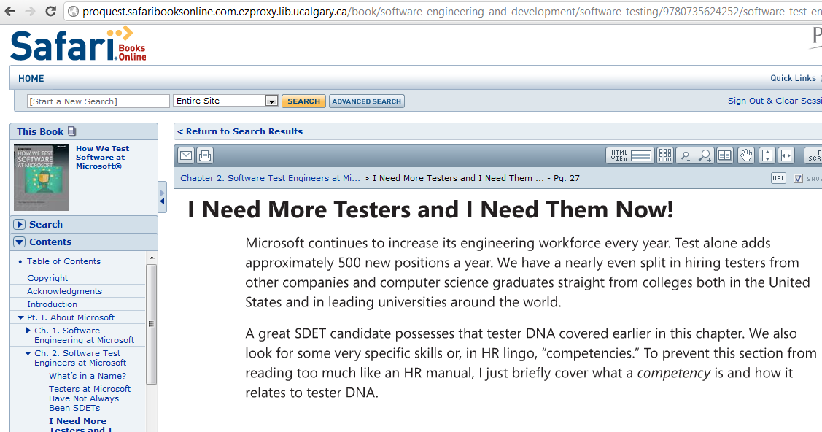
Software test engineers in Microsoft

Slide 12
Outline of the Talk
Background and Introduction
Why is software testing important?
An Overview of SW engineering education research
SW testing research versus SW testing education research
What do we need to teach in testing courses?
What do we need to train top-quality Software Test Engineers?
  Good books
  Good testing tools
  Good teaching materials
  What does the SW industry really need?

Slide 13
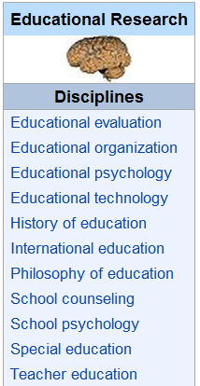
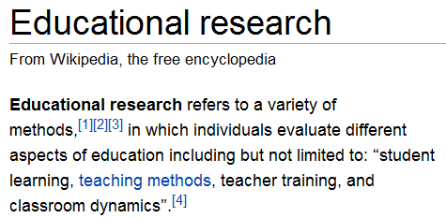



An overview of SW engineering education and training
What is education research?
In SW engineering and Computer Science:

Slide 14


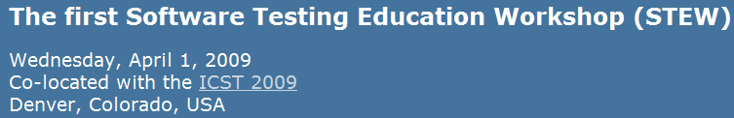
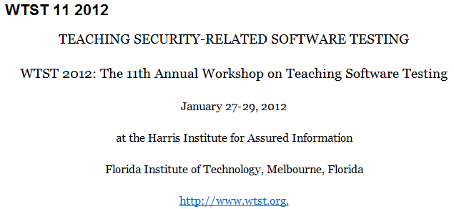
SW testing research versus
SW testing education research
SW testing research venues:
SW testing education research venues:
I was the PhD symposium co-chair this year, sponsored by IEEE CS
a co-organizer

Slide 15
Outline of the Talk
Background and Introduction
An Overview of SW engineering education research
SW testing research versus SW testing education research
What do we need to teach in testing courses?
What do we need to train top-quality Software Test Engineers?
  Good books
  Good testing tools
  Good teaching materials
  What does the SW industry really need?

Slide 16

What do we need to teach in testing courses?
 | Math | Programming | Software Engineering | Domain
Test Design – Criteria-based
Test Design – Human-based
Test Automation | - |  | -
Test Evaluation | - | - | -
Source:
High
Medium
Low

Slide 17
What do we need to train top-quality Software Test Engineers?
Good educators
Good books
Good testing tools
Good teaching materials
  Lecture materials
  Practical lab exercises
  …
And what does the SW industry really need? (matching their needs)

Slide 18
What do we need to train top-quality Software Test Engineers?
Knowledgeable educators (obvious!)
Good books
Good testing tools
Good teaching materials
  Lecture materials
  Practical lab exercises
  …
And what does the SW industry really need? (matching their needs)

Slide 19


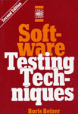

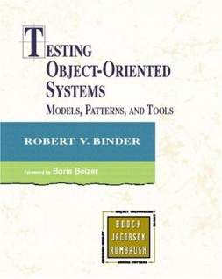
What do we need to train top-quality Software Test Engineers?
Good educators
Good books
Good testing tools
Good teaching materials
  Lecture materials
  Practical lab exercises
And what does the SW industry really need?
There are many (about 197!)
We have recently conducted a systematic mapping (survey) on testing books, using the Google Books database
A paper is now under publication
NOT easy to choose good books
Trend of SW testing books published from 1979-2009:

Slide 20
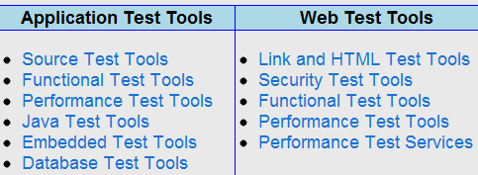
What do we need to train top-quality Software Test Engineers?
Good educators
Good books
Good testing tools
Good teaching materials
  Lecture materials
  Practical lab exercises
And what does the SW industry really need?
There are so many of them
Question 1: which ones are good to be taught/used in the university/corporate courses?
Question 2: How much test concepts and test theory we should teach versus using test tools in our courses?

Slide 21

What do we need to train top-quality Software Test Engineers?
Good educators
Good books
Good testing tools
Good teaching materials
  Lecture materials
  Practical lab exercises
And what does the SW industry really need?
To systematically analyze and compare the state of practice in teaching testing courses
We conducted a survey of SW testing courses in North America in 2009
Presented in the 8th Workshop on Teaching Software Testing (WTST), Melbourne, Florida, 2009
Since 2008, we have developed a repository of modern software testing laboratory courseware consisting of 6 (so far) large-scale practical exercises
IEEE Conference on Software Engineering Education and Training (CSEE&T)
Some details will be presented in this talk…

Slide 22
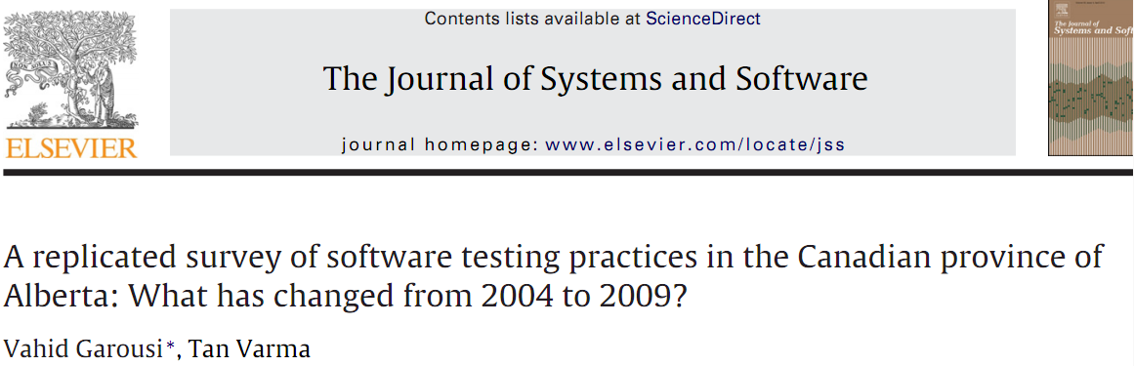
What do we need to train top-quality Software Test Engineers?
Good educators
Good books
Good testing tools
Good teaching materials
  Lecture materials
  Practical lab exercises
And what does the SW industry really need? (matching their needs)
To investigate this we have conducted two surveys…
One in 2009
  Only in the province of Alberta
  53 participants
  Paper published in 2010
  Itself, a replication of an earlier 2004 survey (by other researchers in Alberta).
And another in 2010
  Canada-wide
  About 270 participants
  Paper in press
Some of the results will be presented…

Slide 23
Testing course at … | Testing tool(s) | SUT(s)
Carleton University | JUnit | A simple hypothetical landing gear safety system, and an Automatic Teller Machine
Florida Institute of Technology | None (students apparently used the black-box techniques manually). | Presentation tool, part of the Open Office suite
University of Waterloo | JUnit, CPPUnit | A VoIP application developed by students in a previous course
Purdue University | JUnit | A simple Triangle class
 | xSuds (coverage analysis tool) | A 73-LOC C program
 | Telcordia AR Greenhouse Efficient Test Case Generation Service (AETG) | A hypothetical library checkout system
 | JMeter | www.google.com
 | ProteumIM-2.0 (mutation tool) | A 49-LOC C program
University of Maryland | JUnit | A small-scale office suite called TerpOffice (developed at UMD)
Queen's University | Tests were automated using Unix command-line scripts | A small library book loan system

Slide 24
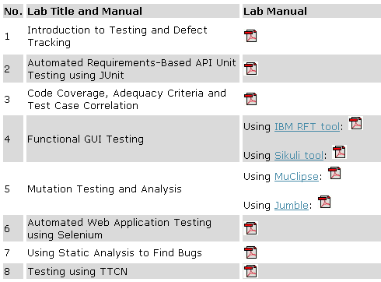
In Proc. Of IEEE Conference on Software Engineering Education and Training (CSEE&T)
It is open-source and online: www.softqual.ucalgary.ca/projects/testing_labs
Being used by 35+ testing educators in 12+ countries: USA, Canada, Ireland, Portugal, Italy, Netherlands, Poland, Norway, Denmark, Luxembourg, India, Iran, Pakistan, Bangladesh, Egypt
We will briefly review in In this talk

Slide 25
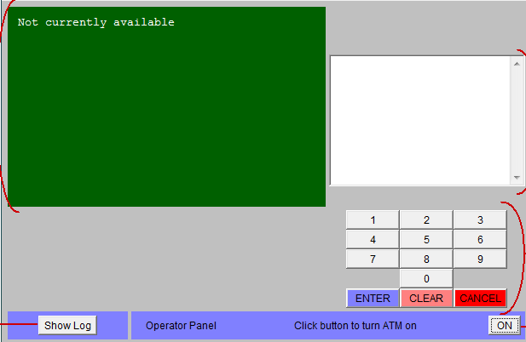
Lab 1.
Introduction to Exploratory Testing and Defect Tracking
Goals:
  Getting hands-on experience in exploratory, manual and regression testing
  Using industrial defect tracking practices and tools (JIRA and Bugzilla)
  Experiencing that ad-hoc testing is not always very effective
SUT: An ATM simulation system
Testing support tool: JIRA and
Bugzilla
Realistic defects were manually injected in the SUT

Slide 26
Lab 1.
Introduction to Testing and Defect Tracking
Lab document (instructions)…
Extensive effort was spent to prepare clear, concise and “interesting” lab exercises…
Involving a recent good student helped a lot in this aspect

Slide 27
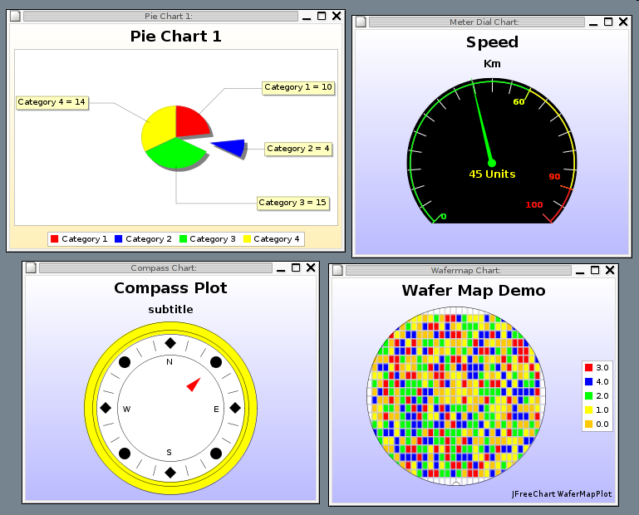
Lab 2. Requirements-Based Test Generation
Goals:
  Using black-box test techniques to derive unit tests from Javadoc API Specifications
  Using JUnit
SUT: JFreeChart
Testing tool: JUnit

Slide 28
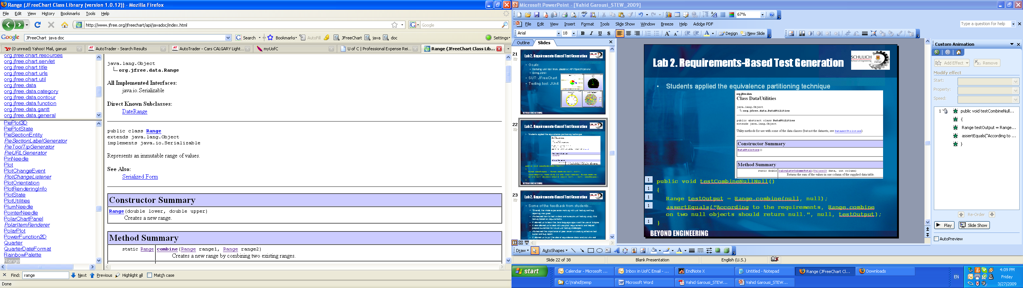
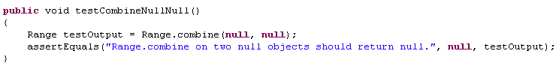
Lab 2. Requirements-Based Test Generation
Students applied the equivalence partitioning technique based on Javadoc API Specifications

Slide 29
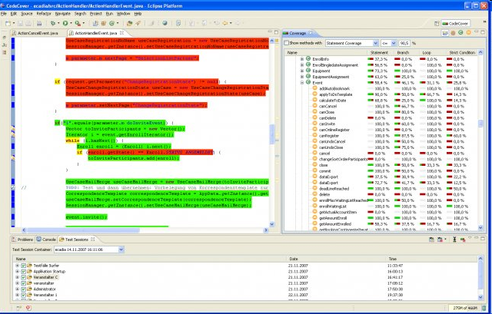
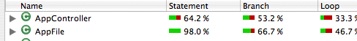
Lab 3: Code Coverage, Adequacy Criteria and
Test Case Correlation
SUT: JFreeChart (the test suites of lab 2)
Testing tools:
  JUnit
  CodeCover
  CoverLipse
In this lab, students enhanced the code coverage of the test suites they had developed in lab 2.

Slide 30
What do we need to train top-quality Software Test Engineers?
Good educators
Good books
Good testing tools
Good teaching materials
  Lecture materials
  Practical lab exercises
And what does the SW industry really need? (matching their needs)
To investigate this we have conducted two surveys…
One in 2009
  Only in the province of Alberta
  53 participants
  Paper published in 2010
  Itself, a replication of an earlier 2004 survey (by other researchers in Alberta).
And another in 2010
  Canada-wide
  246 participants
  Paper in press
Some of the results will be presented…

Slide 31
What should a good Software Test Engineer know?
Knowledge transfer/
Corporate training
Software Engineering Academia
Software Industry
Analysis of needs/ skills shortage

Slide 32
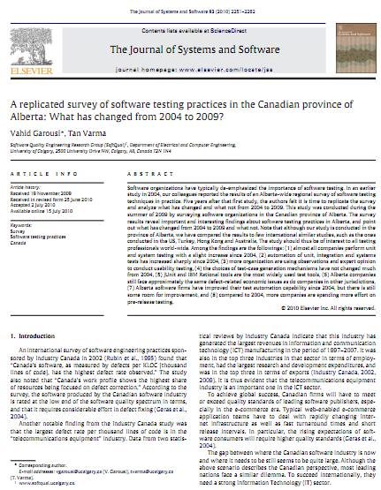
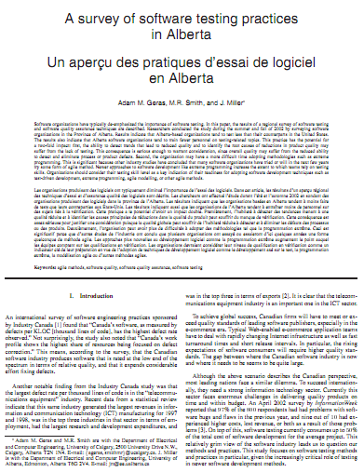
Surveys of SW testing practices in Alberta (2009) and Canada (2010)
Goal: To get a broad picture of the SW testing practices, knowledge and skill needs in Alberta and Canada
Our colleagues had done an earlier Alberta-wide survey in 2004
We repeated it in 2009
In 2010, we improved the questions and did it across Canada
Some results next…
Please see the
articles for details.

Slide 33


Surveys of SW testing practices in Alberta (2009)
Respondents:
  53 respondents
  To get a measure of the sample size…
  According to StatsCan, as of 2007, there were 2,947 SW developers (publishers) in AB
  Assuming about a third of them are doing testing. Thus: about 1,000 SW testers in AB
  Thus sample size: 53/1000=5.3%
Questions were developed and categorized using the IEEE SWEBOK

Slide 34
Surveys of SW testing practices in Alberta
Results for seven of the questions to be presented next…
Aspect | Questions
Respondents Profiles | Company profile: Please summarize your company and the type of projects you do in a few keywords. What best describes your current position? What is the size of your company (number of employees)? Which programming languages do you use in your company?
Test levels | Have you received any formal software-testing related training? Does your organization have a training program that specifically targets any of the following? In your current or most recent software project, did the team conduct the following tests? In your current or most recent project, did the team automate any of the tests? What forms of usability testing are commonly employed in your organization?
Test techniques | Which testing tools and frameworks do you use in your company? In your current or most recent software project, what mechanisms did the team use to generate test cases? Which of the following defect prevention techniques are regularly utilized in your organization?
Test-related measures | In your current or most recent software project, did the team use any of the following measurements as a guide to planning or designing the tests?
Test process management | In your current or most recent project, was the testing environment separate from the development or production environments? Please identify the ratio of developers to testers in your current or most recent project. What percentage of the pre-release work effort is spent on testing? Please rank the following defect types by the effort required to fix that type of defect. What criteria does your organization utilize to terminate the testing phase? What barriers do you believe prevents your company from adopting testing methodology and testing tools? What barriers do you believe prevents your company from providing software training to testing staff?
Testing education
Testing concepts

Slide 35
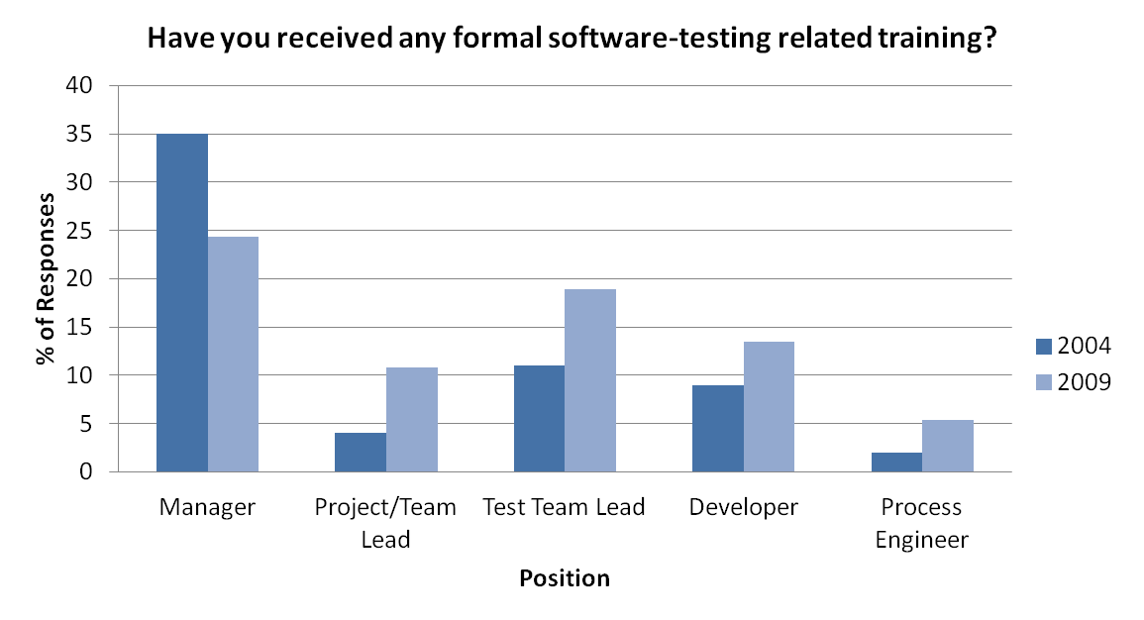
Surveys of SW testing practices in Alberta
SW Testing Training/Education

Slide 36
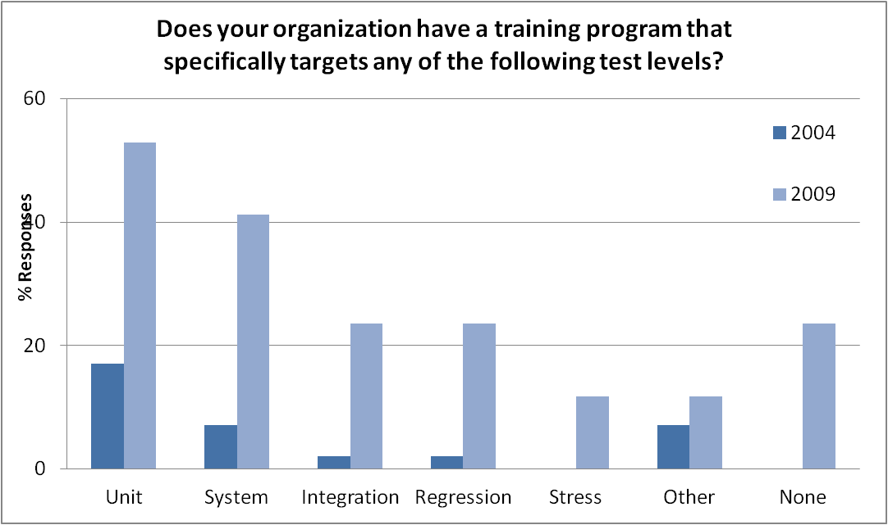
Surveys of SW testing practices in Alberta
SW Testing Training/Education

Slide 37
Surveys of SW testing practices in Alberta
Types of Testing (Test Levels)
Almost all companies perform unit and system testing.

Slide 38
Surveys of SW testing practices in Alberta
Test Automation
Automation of unit, integration and systems tests has increased sharply since 2004.

Slide 39
Surveys of SW testing practices in Alberta
Test tools and frameworks
JUnit and IBM Rational tools are the most widely used test tools.
(reported once)

Slide 40
Surveys of SW testing practices in Alberta
Techniques for identifying test cases
The choices of test-case generation mechanisms have not changed much.
Systematic techniques are used less.

Slide 41
Summary of the Talk
Background and Introduction
An Overview of SW engineering education research
SW testing research versus SW testing education research
What do we need to teach in testing courses?
What do we need to train top-quality Software Test Engineers?
  Good books
  Good testing tools
  Good teaching materials
  What does the SW industry really need?
Q/A

