Slide 1
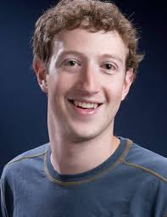
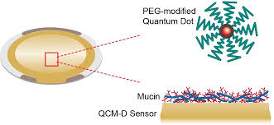
Name
Degree
Field of interest
Daniel Sweethill
ME, Electrical Engineering
Medical Ultrasound
Keywords of research (5 max)
Beam forming FEM simulation, CMUT, Matlab signal processing
Your picture
Skills (5 max)
COMSOL FEM, Matlab, Python, LabView
Looking for (5 max)
Open to new areas beyond medical, team to learn from, enjoy math, but also hands-on measurements
Graduation date
Potential start date
Living in
Relocate to other city ok?
Relocate to other country?
May 2017
June 2017
Rome, Italy
Yes
Yes (Europe only)
Key image of
your research
Contact information
DanielSweethill@gmail.com

